Slide 1

Chapter 3
Brute Force and
Exhaustive Search
Copyright © 2007 Pearson Addison-Wesley. All rights reserved.

Slide 2
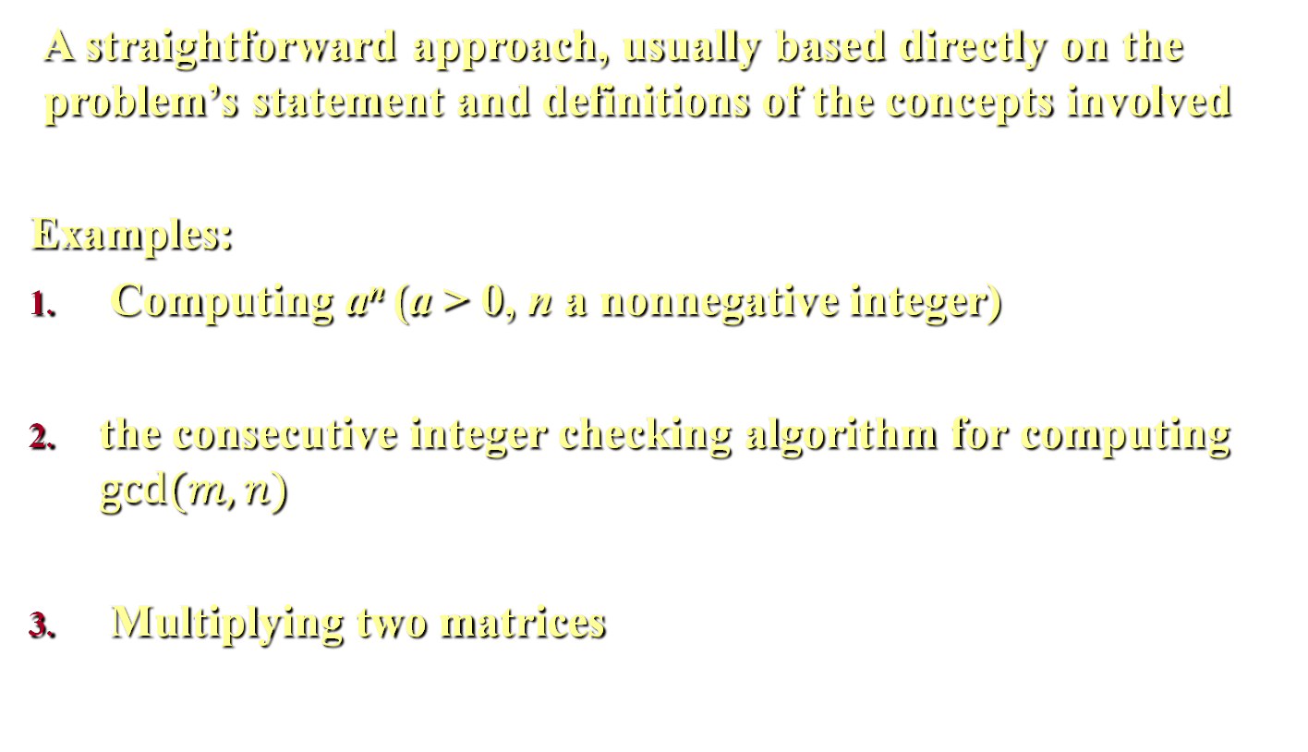
Brute Force
A straightforward approach, usually based directly on the problem’s statement and definitions of the concepts involved
Examples:
Computing a^{n} (a > 0, n a nonnegative integer)
the consecutive integer checking algorithm for computing $gcd⁡(m, n)$
Multiplying two matrices
Notes:
After introducing the framework and methods for algorithm analysis in the preceding chapter, we are ready to discuss algorithm design strategies. Each of the next eight chapters is devoted to a particular design strategy. The subject of this chapter is brute force and its important special case, exhaustive search.
Brute force is a straightforward approach to solving a problem, usually directly based on the problem statement and definitions of the concepts involved.
As an example, consider the exponentiation problem: compute an for a nonzero number $a$ and a nonnegative integer $n$. This suggests simply computing $a^{n}$ by multiplying $1$ by $a$, $n$ times.
We have already encountered at least two brute-force algorithms in the book: the consecutive integer checking algorithm for computing $gcd⁡(m, n)$ in Section 1.1 and the definition-based algorithm for matrix multiplication in Section 2.3.

Slide 3
Brute-Force Sorting Algorithm
The two algorithms discussed here are:
Selection sort
Bubble sort
Notes:
Here, we consider the application of the brute-force approach to the problem of sorting: given a list of n orderable items (e.g., numbers, characters from some alphabet, character strings), rearrange them in nondecreasing order.

Slide 4
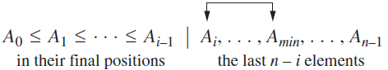
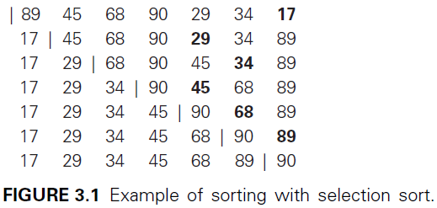
Selection sort
Notes:
Scan the array to find its smallest element and swap it with the first element. Then, starting with the second element, scan the elements to the right of it to find the smallest among them and swap it with the second elements. Generally, on pass $i (0  i  n−2)$, find the smallest element in $A[i..n−1]$ and swap it with $A\left[i\right]$.
As an example, the action of the selection sort on the list 89, 45, 68, 90, 29, 34, 17, is illustrated in Figure 3.1.

Slide 5
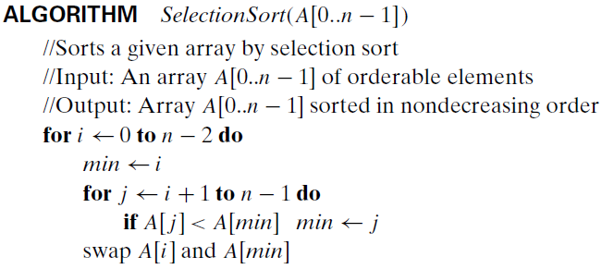


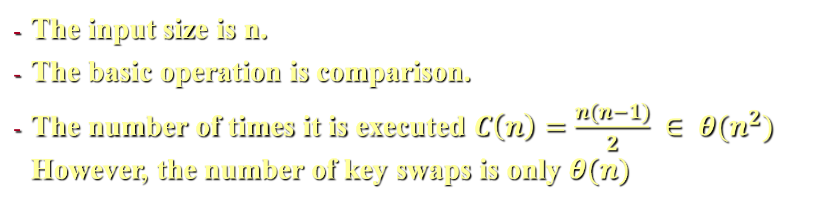


Analysis of Selection Sort
The input size is n.
The basic operation is comparison.
The number of times it is executed $C\left(n\right)=\frac{n(n−1)}{2} ∈ θ(n^{2})$ However, the number of key swaps is only $θ(n)$
Notes:
The analysis of selection sort is straightforward.
The input size is given by the number of elements n.
The basic operation is the key comparison A[j ]<A[min].
The number of times it is executed depends only on the array size and is given by the following sum: $C\left(n\right)=\sum_{i=0}^{n−2}{\sum_{j=i+1}^{n−1}{1}=}\sum_{i=0}^{n−2}{(n−1−i)=\frac{n(n−1)}{2}}$
Thus, selection sort is a $θ(n^{2})$ algorithm on all inputs. Note, however, that the number of key swaps is only $θ(n)$, or, more precisely, $θ(n−1)$ (distinguishes selection sort positively from many other sorting algorithms. one for each repetition of the i loop).This property

Slide 6
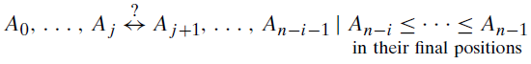
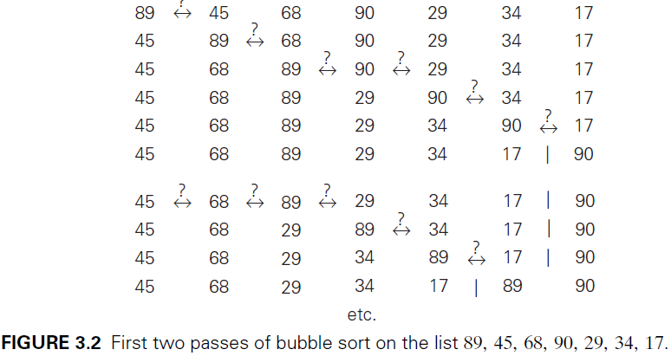
Bubble sort
Notes:
Compare adjacent elements of the list and exchange them if they are out of order. By doing it repeatedly, we end up “bubbling up” the largest element to the last position on the list. The next pass bubbles up the second largest element, and so on, until after $n − 1$ passes the list is sorted.
The action of Bubble sort on the list 89, 45, 68, 90, 29, 34, 17 is illustrated as an example in Figure 3.2.

Slide 7
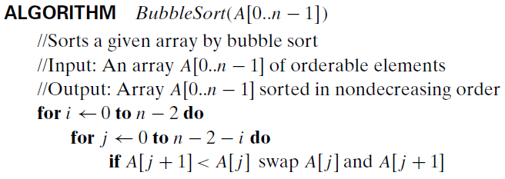
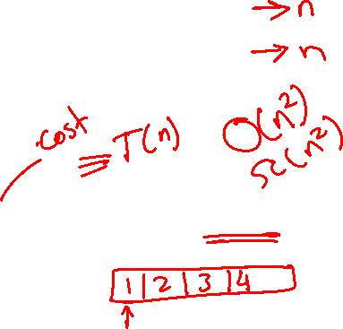
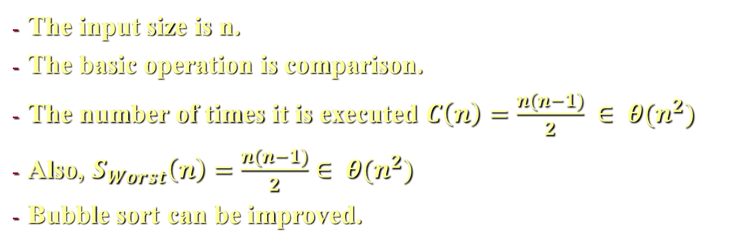
Analysis of Bubble sort
The input size is n.
The basic operation is comparison.
The number of times it is executed $C\left(n\right)=\frac{n(n−1)}{2} ∈ θ(n^{2})$
Also, $S_{Worst}\left(n\right)=\frac{n(n−1)}{2}∈ θ(n^{2})$
Bubble sort can be improved.
Notes:
Above, is the pseudocode of this algorithm.
The number of key comparisons for the bubble-sort version given above is the same for all arrays of size n; it is obtained by a sum that is almost identical to the sum for selection sort: $C\left(n\right)=\sum_{i=0}^{n−2}{\sum_{j=0}^{n−2−i}{1}=}\sum_{i=0}^{n−2}{(n−1−i)=\frac{n(n−1)}{2}∈ θ(n^{2})}$.
The number of key swaps, however, depends on the input. In the worst case of decreasing arrays, it is the same as the number of key comparisons: $S_{Worst}\left(n\right)=\frac{n(n−1)}{2}∈ θ(n^{2})$.
We can improve the crude version of bubble sort given above by exploiting the following observation: if a pass through the list makes no exchanges, the list has been sorted and we can stop the algorithm (Problem 12a in this section’s exercises). Though the new version runs faster on some inputs, it is still in $θ(n^{2})$ in the worst and average cases. In fact, even among elementary sorting methods, bubble sort is an inferior choice.

Slide 8
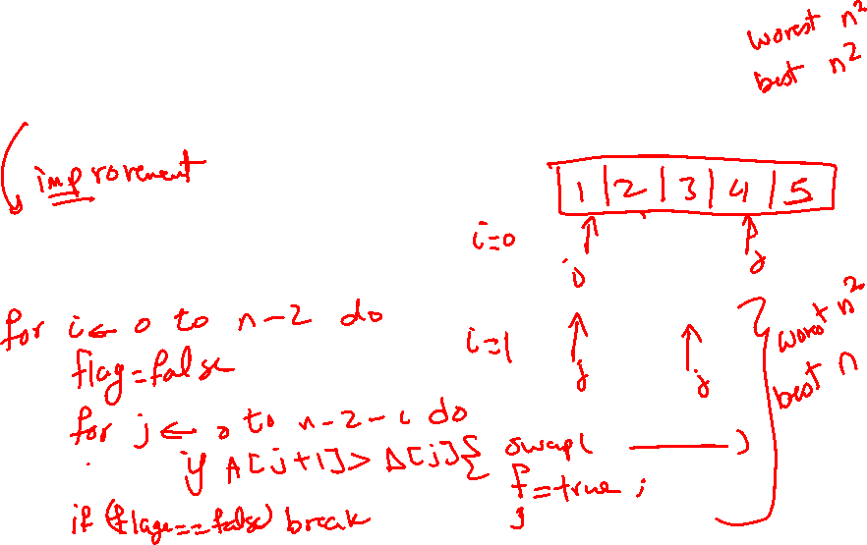

Slide 9

Sequential Search and Brute-Force String Matching
Here we apply brute-force strategy to the problem of searching:
Searching for an item a list
String-matching problem
Notes:
Here we discuss two applications of brute-force strategy to the problem of searching. The first deals with the canonical problem of searching for an item of a given value in a given list. The second is different in that it deals with the string-matching problem

Slide 10
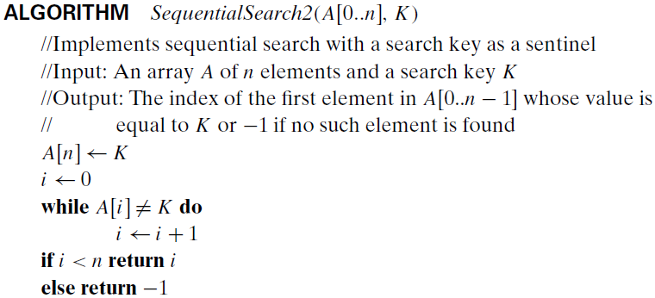

Sequential Search
The algorithm compares successive elements of a list with a search key until either a match is encountered or the list is exhausted.
One improvement is adding the search key to the end of the list.
Notes:
The algorithm simply compares successive elements of a given list with a given search key until either a match is encountered (successful search) or the list is exhausted without finding a match (unsuccessful search).
A simple extra trick is often employed in implementing sequential search: if we append the search key to the end of the list, the search for the key will have to be successful, and therefore we can eliminate the end of list check altogether (instead of writing, while (A[i]$≠$k and i<k) we write while (A[i]$≠$k)). Above, is pseudocode of this enhanced version.

Slide 11
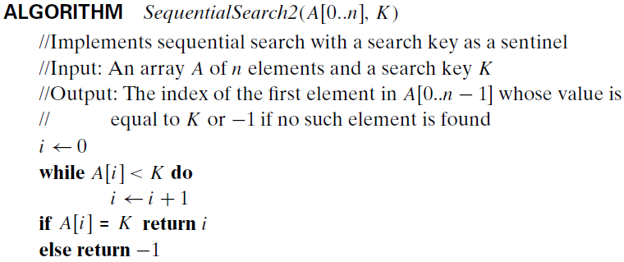
Sequential Search
If a list is sorted, another is to stop the search if an element greater than or equal to the search key is encountered.
Notes:
Another straightforward improvement can be incorporated in sequential search if a given list is known to be sorted: searching in such a list can be stopped as soon as an element greater than or equal to the search key is encountered.

Slide 12
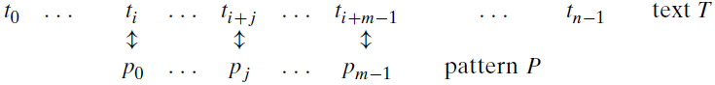
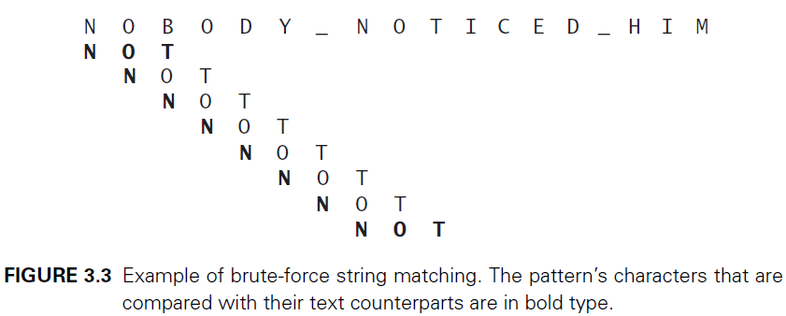


String Matching
Find a substring of a text that matches a pattern.
Notes:
Problem: given a string of $n$ characters called the text and a string of $m$ characters $(m ≤ n)$ called the pattern, find a substring of the text that matches the pattern. The above figure explains the problem where $t_{0},t_{1}, …,t_{i}, …,t_{i+j}, …,t_{i+m−1}, …,t_{n−1}$ are the character of a string of length $n$, and $p_{0},p_{1}, …,p_{j}, …,p_{m−1}$.If matches other than the first one need to be found, a string-matching algorithm can simply continue working until the entire text is exhausted.
The algorithm steps are shown below:
Align the pattern against the first m characters of the text and start matching the corresponding pairs of characters from left to right until either all the m pairs of the characters match (then the algorithm can stop) or a mismatching pair is encountered.
In the latter case, shift the pattern one position to the right and resume the character comparisons, starting again with the first character of the pattern and its counterpart in the text.
Note that the last position in the text that can still be a beginning of a matching substring is n − m (provided the text positions are indexed from 0 to n − 1).
FIGURE 3.3 shows an example of brute-force string matching.

Slide 13
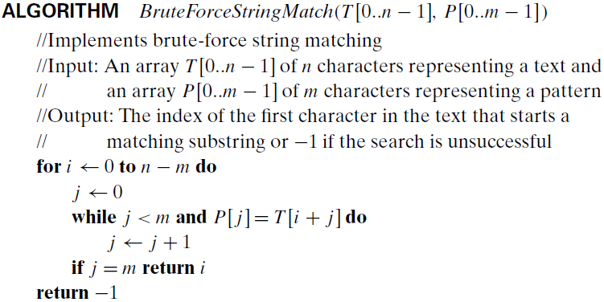
String Matching
$$C\left(n,m\right)=O\left(nm\right);if n=m=⇒O(n)$$
Notes:
The string matching algorithm is shown above.
In the worst case, the algorithm may have to make all m comparisons before shifting the pattern, and this can happen for each of the $n − m + 1$ tries. (Problem 6 in this section’s exercises) Thus, in the worst case, the algorithm makes $m(n − m + 1)$ character comparisons, which puts it in the $O(nm)$ class. For a typical word search in a natural language text, however, we should expect that most shifts would happen after very few comparisons (check the example again). Therefore, the average-case efficiency should be considerably better than the worst-case efficiency. Indeed it is: for searching in random texts, it has been shown to be linear, i.e., $θ(n)$.

Slide 14
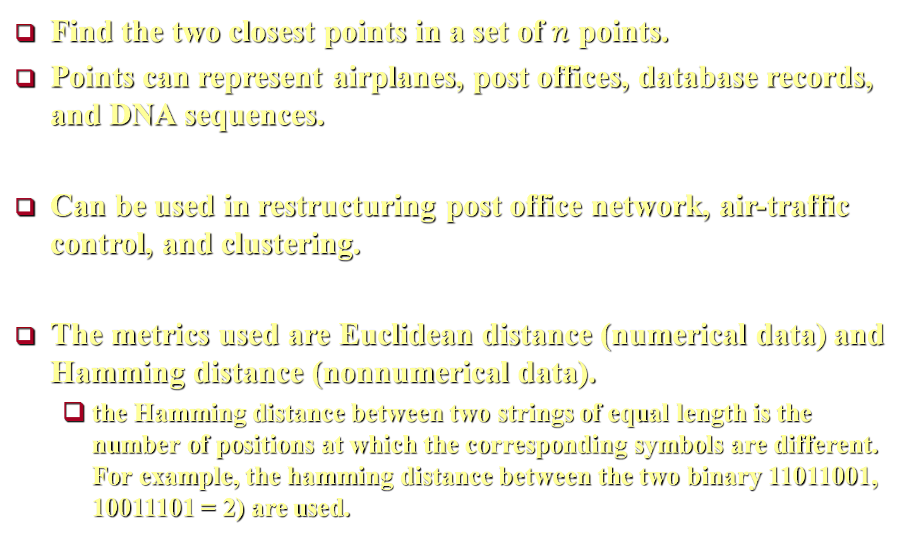
Closest-Pair Problem
Find the two closest points in a set of $n$ points.
Points can represent airplanes, post offices, database records, and DNA sequences.
Can be used in restructuring post office network, air-traffic control, and clustering.
The metrics used are Euclidean distance (numerical data) and Hamming distance (nonnumerical data).
the Hamming distance between two strings of equal length is the number of positions at which the corresponding symbols are different. For example, the hamming distance between the two binary 11011001, 10011101 = 2) are used.
Notes:
The closest-pair problem calls for finding the two closest points in a set of n points.
Points in question can represent such physical objects as airplanes or post offices as well as database records, DNA sequences, and so on.
For example, An air-traffic controller might be interested in two closest planes as the most probable collision candidates. A regional postal service manager might need a solution to the closest pair problem to find candidate post-office locations to be closed. One of the important applications of the closest-pair problem is cluster analysis in statistics. Based on n data points, hierarchical cluster analysis seeks to organize them in a hierarchy of clusters based on some similarity metric. For numerical data, this metric is usually the Euclidean distance; for text and other nonnumerical data, metrics such as the Hamming distance (the Hamming distance between two strings of equal length is the number of positions at which the corresponding symbols are different. For example, the hamming distance between the two binary 11011001, 10011101 = 2) are used.
For simplicity, we consider the two-dimensional case of the closest-pair problem. We assume that the points in question are specified in a standard fashion by their $(x, y)$ Cartesian coordinates and that the distance between two points $p_{i}(x_{i},y_{i})$ and $p_{j}(x_{j},y_{j})$ is the standard Euclidean distance $d\left(p_{i},p_{j}\right)=\sqrt{{(x_{i}−x_{j})}^{2}+{(y_{i}−y_{j})}^{2}}$.
The brute-force approach to solving this problem leads to the following algorithm: compute the distance between each pair of distinct points and find a pair with the smallest distance. Of course, we do not want to compute the distance between the same pair of points twice. To avoid doing so, we consider only the pairs of points $\left(p_{i},p_{j}\right)$ for which $i < j$.
The pseudocode below computes the distance between the two closest points; getting the closest points themselves requires just a trivial modification.

Slide 15
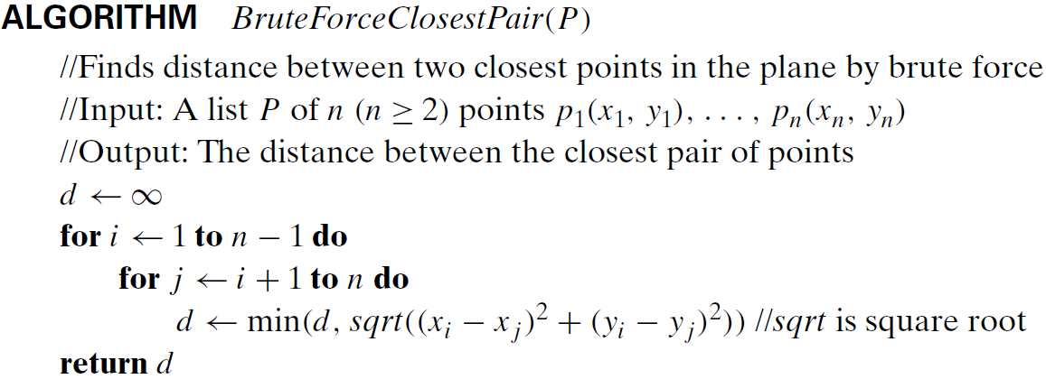
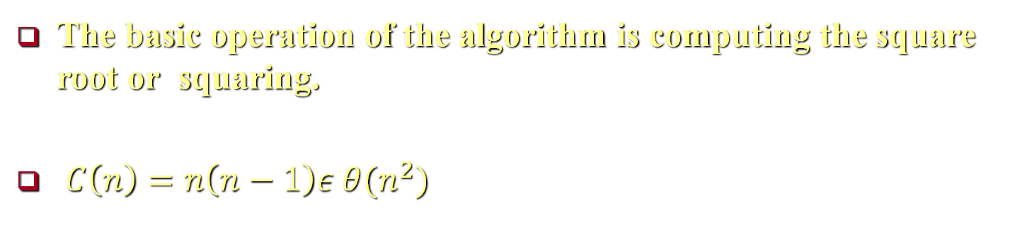
Closest-Pair Problem
The basic operation of the algorithm is computing the square root or squaring.
$C\left(n\right)=n\left(n−1\right)ε θ(n^{2})$
Notes:
The brute-force approach to solving this problem leads to the following algorithm: compute the distance between each pair of distinct points and find a pair with the smallest distance. Of course, we do not want to compute the distance between the same pair of points twice. To avoid doing so, we consider only the pairs of points $\left(p_{i},p_{j}\right)$ for which $i < j$.
The pseudocode above computes the distance between the two closest points; getting the closest points themselves requires just a trivial modification.
The basic operation of the algorithm is computing the square root. Computing the square root is not as simple an operation as, addition or multiplication. Here, computing square roots in the loop can be avoided by simply ignore the square-root function and compare the values ${(x_{i}−x_{j})}^{2}+{(y_{i}−y_{j})}^{2}$themselves. We can do this because the smaller a number of which we take the square root, the smaller its square root. Then the basic operation of the algorithm will be squaring a number. The number of times it will be executed can be computed as follows: $C\left(n\right)=\sum_{i=1}^{n−1}{\sum_{j=i+1}^{n}{2}}=2\sum_{i=1}^{n−1}{(n−i)}=2\left[\left(n−1\right)+\left(n−2\right)+ …+1\right]=n\left(n−1\right)ε θ(n^{2})$.

Slide 16

Convex-Hull Problem
Convex-hull can be used in many applications.
Speeds up collision detection.
Detecting outliers
Computing a diameter of a set of points
Notes:
Convex-hull can be used in many applications. For example, in computer animation, replacing objects by their convex hulls speeds up collision detection. The same idea is used in path planning for Mars mission rovers. They are also used for detecting outliers by some statistical techniques. Also, it is an efficient algorithm for computing a diameter of a set of points, which is the largest distance between two of the points, needs the set’s convex hull to find the largest distance between two of its extreme points.

Slide 17
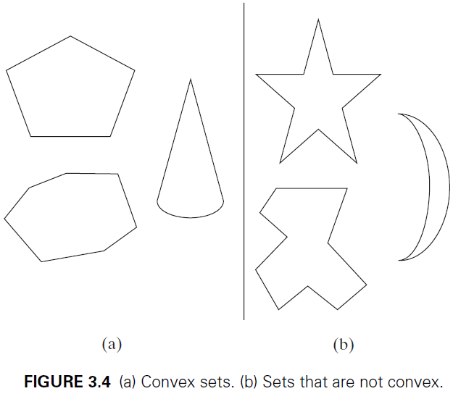
Convex-Hull Problem
Convex and non-convex sets
Notes:
A set of points (finite or infinite) in the plane is called convex if for any two points p and q in the set, the entire line segment with the endpoints at p and q belongs to the set.
All the sets depicted in Figure 3.4a are convex, and so are a straight line, a triangle, a rectangle, and, more generally, any convex polygon,1 a circle, and the entire plane. On the other hand, the sets depicted in Figure 3.4b, any finite set of two or more distinct points, the boundary of any convex polygon, and a circumference are examples of sets that are not convex.

Slide 18
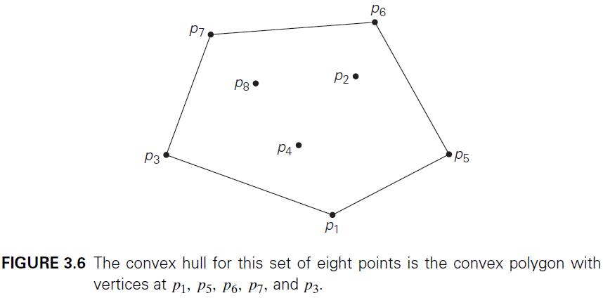
Convex-Hull Problem
Convex hull of a set of points $S$
Notes:
The convex hull of a set S of points is the smallest convex set containing S.
If S is convex, its convex hull is obviously S itself. If S is a set of two points, its convex hull is the line segment connecting these points. If S is a set of three points not on the same line, its convex hull is the triangle with the vertices at the three points given; if the three points do lie on the same line, the convex hull is the line segment with its endpoints at the two points that are farthest apart.
An example of the convex hull for a larger set, is shown in Figure 3.6.

Slide 19
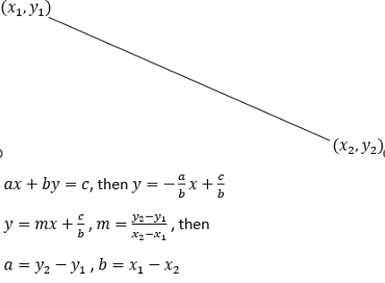


Convex-Hull Problem
Substituting $(x,y)$ in equation $ax+by=c$ with $(x_{1},y_{1})$, we get $c=x_{1}y_{2}−y_{1}x_{2}$
The time efficiency of this algorithm is in $O(n^{3})$
Notes:
The straight line through two points $(x_{1},y_{1})$, $(x_{2},y_{2})$ can be defined by the equation $ax+by=c$. Then $y=−\frac{a}{b}x+\frac{c}{b}$
Since $y=mx+\frac{c}{b}$ , $m=\frac{y_{2}−y_{1}}{x_{2}−x_{1}}$ then $a=y_{2}−y_{1}$ , $b=x_{1}−x_{2}$
Substituting $(x,y)$ in equation $ax+by=c$ with $(x_{1},y_{1})$, we get $c=x_{1}y_{2}−y_{1}x_{2}$
The line divides the plane into two half-planes: for all the points in one of them, $ax+by>c$, while for all the points in the other, $ax+by=c$. (For the points on the line itself, of course, $ax+by=c$.) Thus, to check whether certain points lie on the same side of the line, we can simply check whether the expression $ax+by−c$ has the same sign for each of these points.
The time efficiency of this algorithm is in $O(n^{3})$: for each of $n(n − 1)/2$ pairs of distinct points, we may need to find the sign of $ax + by − c$ for each of the other $n − 2$ points. There are much more efficient algorithms for this important problem, and we discuss one of them later in the course.

Slide 20
void convexHull(point *array)
{ double a,b,c,checkVal,found;
for (int i = 0; i < 8; i++)
{
for (int j = i+1; j < 8; j++)
{
found = 0;
a = array[j].y - array[i].y;
b = array[j].x - array[i].x;
c = (array[i].x * array[j].y) - (array[i].y * array[j].x);
for (int k = 0; k < 8;k++)
{
checkVal = (a * array[k].x) + (b * array[k].y) - c;
if (checkVal == 0)
{
found = 1;
break;
}
}
if (found == 1)
{
printf("%lf %lf\n",nums[i].x,nums[j].y);
}
}
}
}

Slide 21
Exhaustive Search
Exhaustive search is a brute-force approach to combinatorial problems by generating each and every element of the problem domain, selecting those of them that satisfy all the constraints, and then finding a desired element.
We illustrate exhaustive search by applying it to three important problems:
The traveling salesman problem
The knapsack problem
The assignment problem.
Notes:
Exhaustive search is simply a brute-force approach to combinatorial problems (that involve combinatorial objects such as permutations, combinations, and subsets of a given set). It suggests generating each and every element of the problem domain, selecting those of them that satisfy all the constraints, and then finding a desired element (e.g., the one that optimizes some objective function).

Slide 22
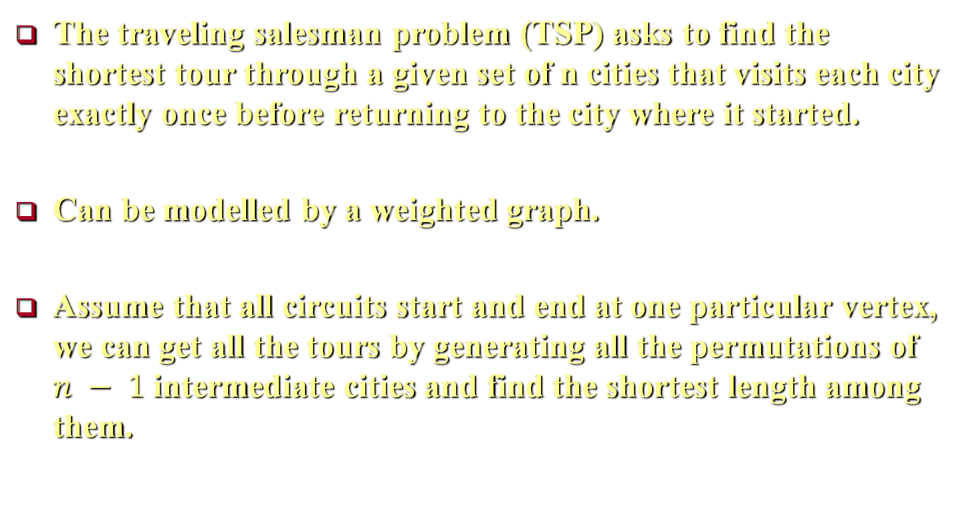
Traveling Salesman Problem (TSP)
The traveling salesman problem (TSP) asks to find the shortest tour through a given set of n cities that visits each city exactly once before returning to the city where it started.
Can be modelled by a weighted graph.
Assume that all circuits start and end at one particular vertex, we can get all the tours by generating all the permutations of $n − 1$ intermediate cities and find the shortest length among them.
Notes:
The traveling salesman problem (TSP) asks to find the shortest tour through a given set of n cities that visits each city exactly once before returning to the city where it started.
The problem can be modeled by a weighted graph, with the graph’s vertices representing the cities and the edge weights specifying the distances. Then the problem can be stated as the problem of finding the shortest Hamiltonian circuit of the graph (A Hamiltonian circuit is defined as a cycle that passes through all the vertices of the graph exactly once).
A Hamiltonian circuit can also be defined as a sequence of $n + 1$ adjacent vertices $v_{i_{0}},v_{i_{1}}, …,v_{i_{n−1}}$, $v_{i_{0}}$, where $i$ represents the vertex index from which we start the sequence, the first vertex of the sequence is the same as the last one, and all the other $n − 1$ vertices are distinct.
We assume that all circuits start and end at one particular vertex. Thus, we can get all the tours by generating all the permutations of n − 1 intermediate cities, compute the tour lengths, and find the shortest among them.

Slide 23
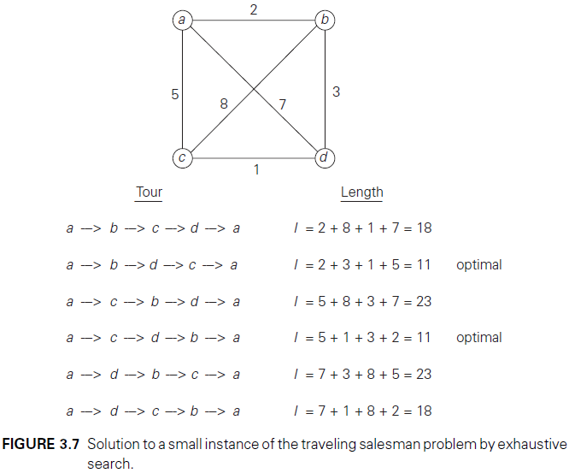
Traveling Salesman Problem (TSP)
Notes:
Figure 3.7 presents a small instance of the problem and its solution by this method.
Figure 3.7 reveals three pairs of tours that differ only by their direction (note that, a exists at the beginning and end, therefore the direction does not matter). Hence, we could cut the number of vertex permutations by half.

Slide 24
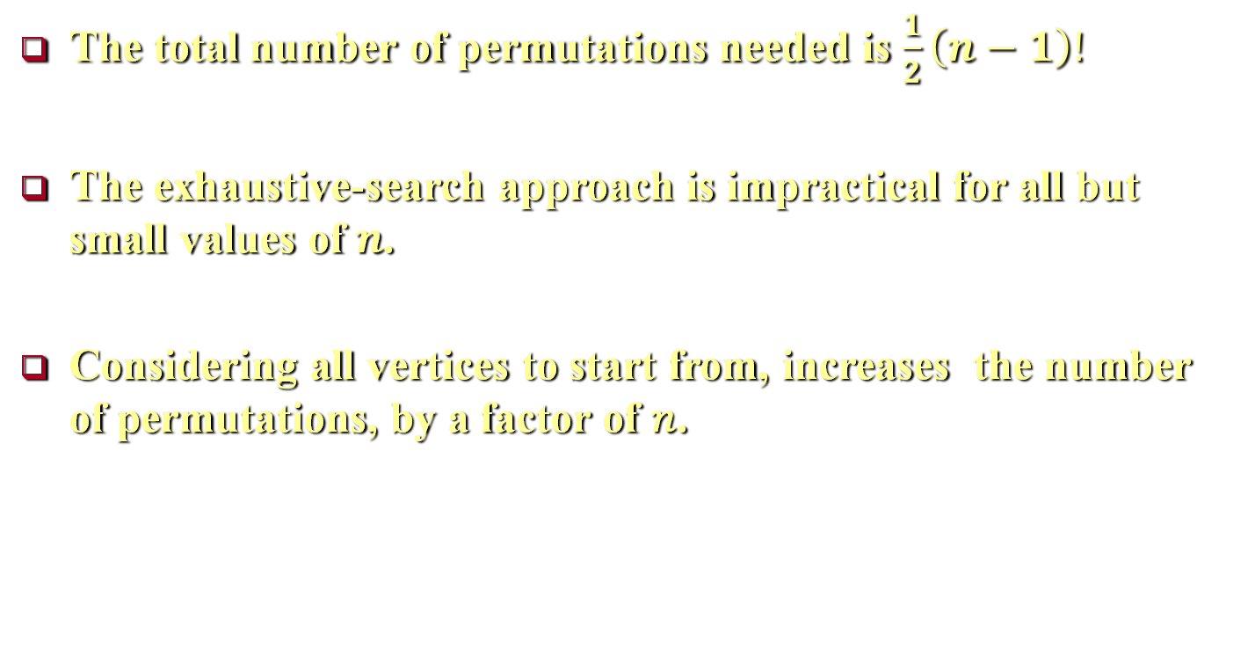

Traveling Salesman Problem (TSP)
The total number of permutations needed is $\frac{1}{2}\left(n−1\right)!$
The exhaustive-search approach is impractical for all but small values of $n$.
Considering all vertices to start from, increases the number of permutations, by a factor of 𝑛.
Notes:
The total number of permutations is $\frac{\left(n−1\right)!}{\left[\left(n−1\right)−\left(n−1\right)\right]!}=\frac{\left(n−1\right)!}{0!}=\left(n−1\right)!$, since we only care about half of them then the total number of permutations needed is $\frac{1}{2}\left(n−1\right)!$, which makes the exhaustive-search approach impractical for all but very small values of $n$. Also note that had we not limited our investigation to the circuits starting at the same vertex, the number of permutations would have been even larger, by a factor of $n$.

Slide 25
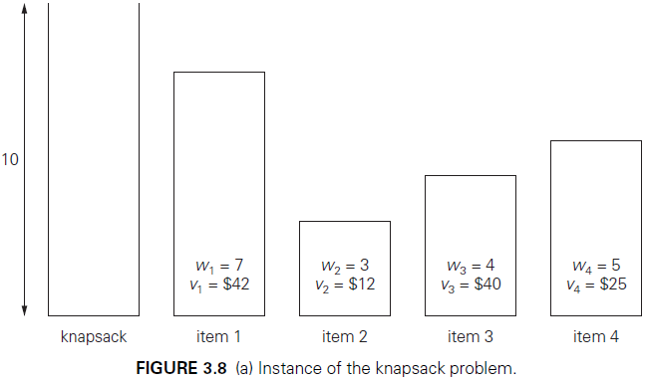

Knapsack Problem
Given n items of known weights $w_{1},w_{2}, …,w_{n}$ and values $v_{1}, v_{2}, …,v_{n}$, and a knapsack of capacity $W$, find the most valuable subset of the items that fit into the knapsack.
Notes:
Given n items of known weights $w_{1},w_{2}, …,w_{n}$ and values $v_{1}, v_{2}, …,v_{n}$, and a knapsack of capacity $W$, find the most valuable subset of the items that fit into the knapsack.
Figure 3.8a presents a small instance of the knapsack problem.

Slide 26
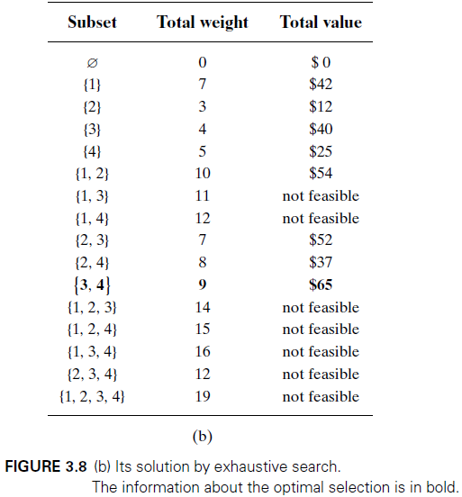

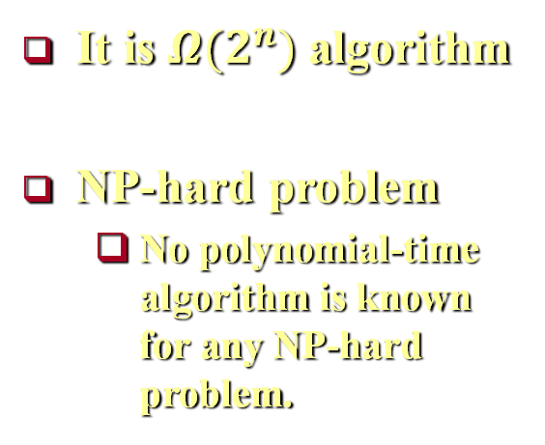
Knapsack Problem
It is $Ω{(2}^{n})$ algorithm
NP-hard problem
No polynomial-time algorithm is known for any NP-hard problem.
Notes:
The exhaustive-search approach to this problem leads to generating all the subsets of the set of $n$ items, computing the total weight of each subset in order to identify feasible subsets (i.e., the ones with the total weight not exceeding the knapsack capacity), and finding a subset of the largest value among them. As an example, the solution to the instance of Figure 3.8a is given in Figure 3.8b. Since the number of subsets of an n-element set is $2^{n}$, the exhaustive search leads to a $Ω{(2}^{n})$ algorithm, no matter how efficiently individual subsets are generated.
For both the traveling salesman and knapsack problems, exhaustive search leads to algorithms that are extremely inefficient, these two problems are NP-hard problem. No polynomial-time algorithm is known for any NP-hard problem.

Slide 27
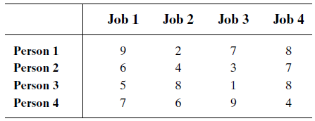

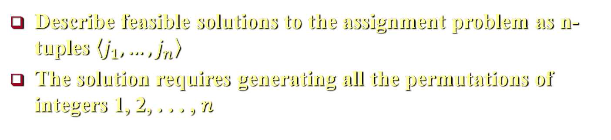
Assignment Problem
Assign $n$ people to execute $n$ jobs
$C[i, j]$ is the cost of assigning ith person to the jth job
Describe feasible solutions to the assignment problem as n-tuples $\left\langle j_{1}, …,j_{n}\right\rangle$
The solution requires generating all the permutations of integers 1, 2, . . . , 𝑛
Notes:
There are $n$ people who need to be assigned to execute $n$ jobs, one person per job. (That is, each person is assigned to exactly one job and each job is assigned to exactly one person). The cost that would accrue if the ith person is assigned to the jth job is a known quantity $C[i, j]$ for each pair $i, j = 1, 2, . . . , n$. The problem is to find an assignment with the minimum total cost. A small instance of this problem with the table entries representing the assignment costs $C[i, j ]$ is shown above.
We can describe feasible solutions to the assignment problem as n-tuples $\left\langle j_{1}, …,j_{n}\right\rangle$ in which the ith component, i = 1, . . . , n, indicates the column of the element selected in the ith row (i.e., the job number assigned to the ith person). For example, for the cost matrix above, $\left\langle 1, 2,3,4\right\rangle$ indicates the assignment of Person 1 to Job 2, Person 2 to Job 3, Person 3 to Job 4, and Person 4 to Job 1.
Therefore, the exhaustive-search approach to the assignment problem would require generating all the permutations of integers $1, 2, . . . , n$, computing the total cost of each assignment by summing up the corresponding elements of the cost matrix, and finally selecting the one with the smallest sum.

Slide 28
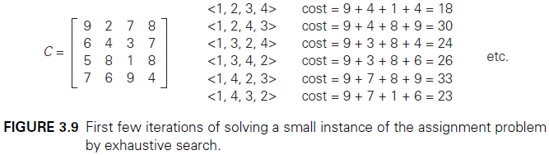
Assignment Problem
The number of permutations is n!
Exhaustive search is impractical for all but very small instances.
Notes:
A few first iterations of applying this algorithm to the instance given above are shown in Figure 3.9; you are asked to complete it in the exercises.
Since the number of permutations to be considered for the general case of the assignment problem is n!, exhaustive search is impractical for all but very small instances of the problem.

Slide 29
Depth-First and Breadth-First Search
Exhaustive search can also be applied to
Depth-first search (DFS)
Breadth-first search (BFS)
Notes:
The term “exhaustive search” can also be applied to two very important algorithms that systematically process all vertices and edges of a graph. These two traversal algorithms are depth-first search (DFS) and breadth-first search (BFS).

Slide 30
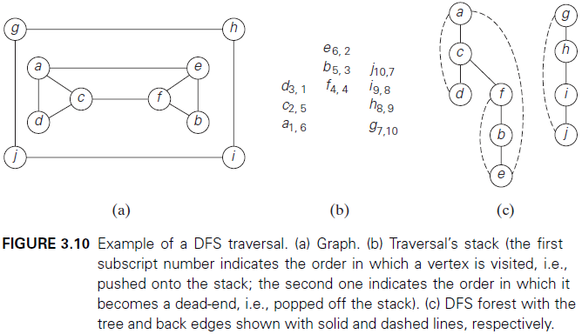
Depth-First Search
Notes:
Depth-first search starts a graph’s traversal at an arbitrary vertex by marking it as visited. On each iteration, the algorithm proceeds to an unvisited vertex that is adjacent to the one it is currently in. (If there are several such vertices, a tie can be resolved arbitrarily. In our examples, we always break ties by the alphabetical order of the vertices). This process continues until a dead end—a vertex with no adjacent unvisited vertices—is encountered. At a dead end, the algorithm backs up one edge to the vertex it came from and tries to continue visiting unvisited vertices from there. The algorithm eventually halts after backing up to the starting vertex from the last dead end. By then, all the vertices in the same connected component as the starting vertex have been visited. If unvisited vertices still remain in another connected component of the graph, the depth-first search must be restarted at an arbitrary vertex of this component of the graph.
It is convenient to use a stack to trace the operation of depth-first search. We push a vertex onto the stack when the vertex is reached for the first time (i.e., the visit of the vertex starts), and we pop a vertex off the stack when it becomes a dead end (i.e., the visit of the vertex ends).
It is also very useful to accompany a depth-first search traversal by constructing the so-called depth-first search forest. The starting vertex of the traversal serves as the root of the first tree in such a forest. Whenever a new unvisited vertex is reached for the first time, it is attached as a child to the vertex from which it is being reached. Such an edge is called a tree edge because the set of all such edges forms a forest. The algorithm may also encounter an edge leading to a previously visited vertex other than its immediate predecessor (i.e., its parent in the tree). Such an edge is called a back edge because it connects a vertex to its ancestor, other than the parent, in the depth-first search forest. Figure 3.10 provides an example of a depth-first search traversal, with the traversal stack and corresponding depth-first search forest shown as well.
Here is pseudocode of the depth-first search.

Slide 31
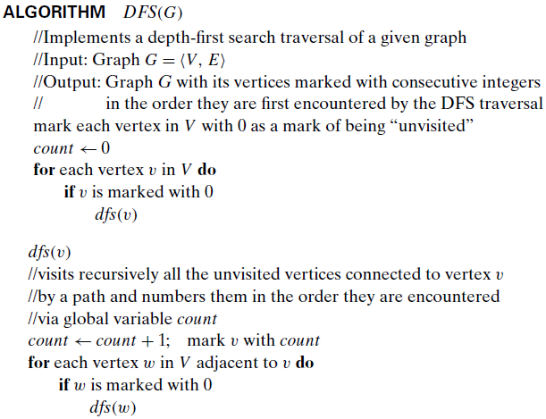
Depth-First Search
Notes:
Above, is the pseudocode of the depth-first search.

Slide 32
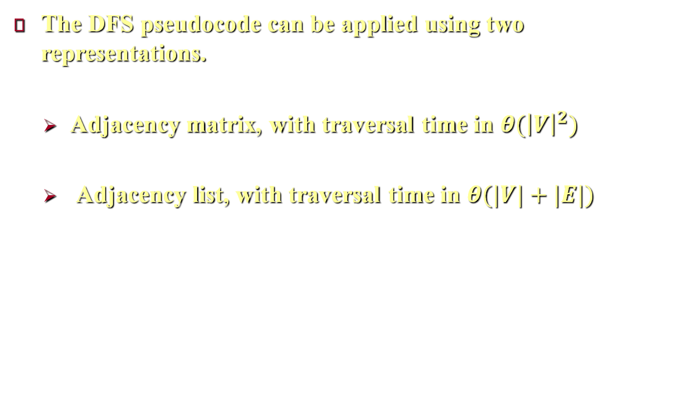
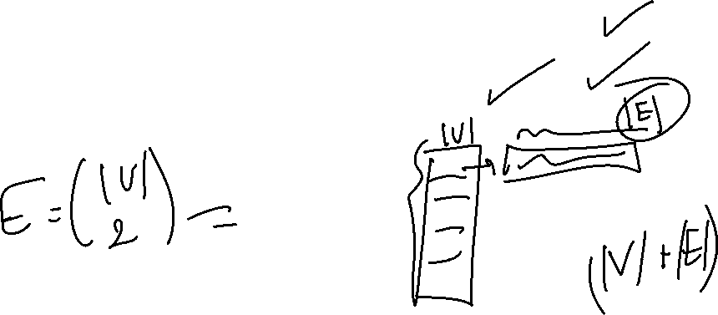
Depth-First Search
The DFS pseudocode can be applied using two representations.
Adjacency matrix, with traversal time in $θ({\left|V\right|}^{2})$
Adjacency list, with traversal time in $θ(|V|+|E|)$
Notes:
The DFS pseudocode looks simple, however it is sophisticated. To appreciate its depth, you should trace the algorithm’s action by looking not at a graph’s diagram but at its adjacency matrix or adjacency lists.
How efficient is depth-first search? For the adjacency matrix representation, the traversal time is in $θ({\left|V\right|}^{2})$ [because in Adjacency Matrix, to tell which vertices are adjacent to a given vertex, we take O(|V|) time, irrespective of edges. i.e., you have to make repeat the basic operation $V$ times for each vertex to get the adjacent vertices to this vertex]. However, for the the adjacency list representation, it is in $θ(\left|V\right|+\left|E\right|)$ [because, in this case, you already have the adjacent vertices, and the basic operation will be repeated exactly $\left|V\right|+\left|E\right|$ times].

Slide 33
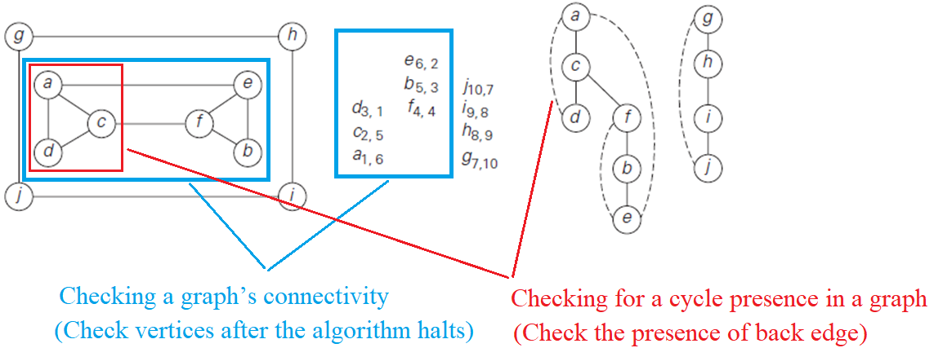
Depth-First Search
Applications of DFS .
Checking a graph’s connectivity
Checking for a cycle presence in a graph
Notes:
Important elementary applications of DFS include checking connectivity and checking acyclicity of a graph.
Since dfs halts after visiting all the vertices connected by a path to the starting vertex, checking a graph’s connectivity can be done as follows. Start a DFS traversal at an arbitrary vertex and check, after the algorithm halts, whether all the vertices of the graph will have been visited. If they have, the graph is connected; otherwise, it is not connected.
As for checking for a cycle presence in a graph, we can take advantage of the graph’s representation in the form of a DFS forest. If the latter does not have back edges, the graph is clearly acyclic, otherwise the graph has a cycle. If there is a back edge from some vertex u to its ancestor v (e.g., the back edge from d to a in Figure 3.10c), the graph has a cycle that comprises the path from v to u via a sequence of tree edges in the DFS forest followed by the back edge from u to v.

Slide 34
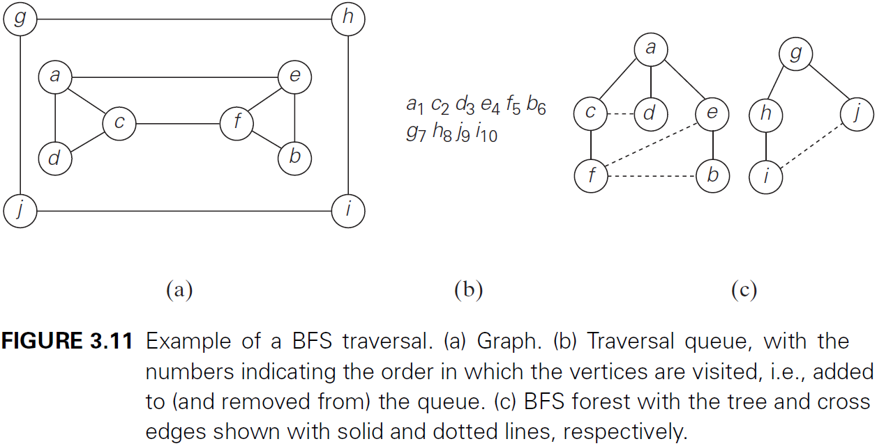
Breadth-First Search
Notes:
Breadth-First Search (BFS) visits first all the vertices that are adjacent to a starting vertex, then all unvisited vertices two edges apart from it, and so on, until all the vertices in the same connected component as the starting vertex are visited. If there still remain unvisited vertices, the algorithm has to be restarted at an arbitrary vertex of another connected component of the graph.
It is convenient to use a queue to trace the operation of breadth-first search. The queue is initialized with the traversal’s starting vertex, which is marked as visited. On each iteration, the algorithm identifies all unvisited vertices that are adjacent to the front vertex, marks them as visited, and adds them to the queue; after that, the front vertex is removed from the queue.
Similarly to a DFS traversal, it is useful to accompany a BFS traversal by constructing the so-called breadth-first search forest. The traversal’s starting vertex serves as the root of the first tree in such a forest. Whenever a new unvisited vertex is reached for the first time, the vertex is attached as a child to the vertex it is being reached from with an edge called a tree edge. If an edge leading to a previously visited vertex other than its immediate predecessor (i.e., its parent in the tree) is encountered, the edge is noted as a cross edge. Figure 3.11 provides an example of a breadth-first search traversal, with the traversal queue and corresponding breadth-first search forest shown.

Slide 35
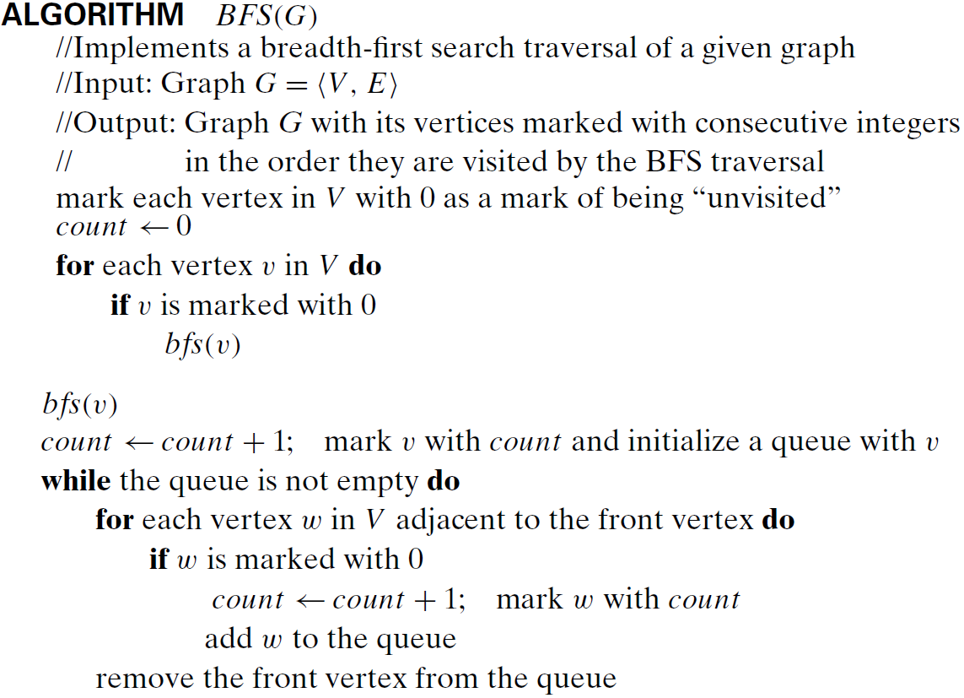
Breadth-First Search
Notes:
The pseudocode of the breadth-first search is shown above.

Slide 36
Breadth-First Search
BFS has the same efficiency as DFS.
Unlike the DFS which yields two orderings of vertices, BFS yields a single ordering.
Applications of DFS .
Checking a graph’s connectivity
Checking for a cycle presence in a graph
Finding a path with the fewest number of edges between two given vertices
Notes:
Breadth-first search has the same efficiency as depth-first search: it is in $θ({\left|V\right|}^{2})$ For the adjacency matrix representation, and in $θ(\left|V\right|+\left|E\right|)$ for the adjacency list representation.
Unlike the DFS which yields two orderings of vertices: the order in which the vertices are reached for the first time (pushed onto the stack) and the order in which the vertices become dead ends (popped off the stack), BFS yields a single ordering of vertices because it uses queue data structure.
BFS can be used to check connectivity and acyclicity of a graph, essentially in the same manner as DFS can.
it can be helpful in some situations where DFS cannot. For example, BFS can be used for finding a path with the fewest number of edges between two given vertices.

Slide 37
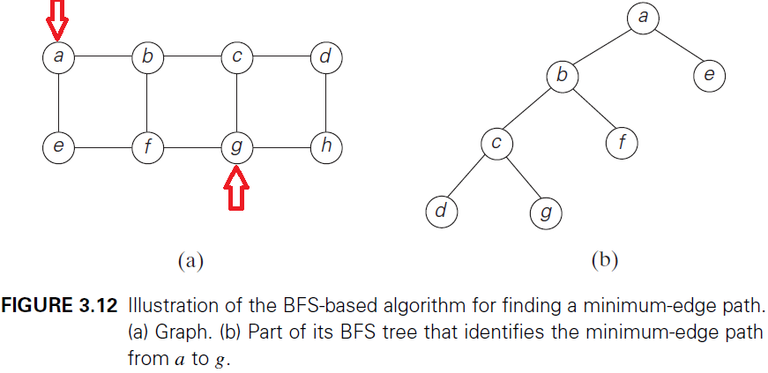
Breadth-First Search
Notes:
To do this, we start a BFS traversal at one of the two vertices and stop it as soon as the other vertex is reached. The simple path from the root of the BFS tree to the second vertex is the path sought (this because BFS searches for vertices in the adjacent level). For example, path a − b − c − g in the graph in Figure 3.12 has the fewest number of edges among all the paths between vertices a and g.

Slide 38
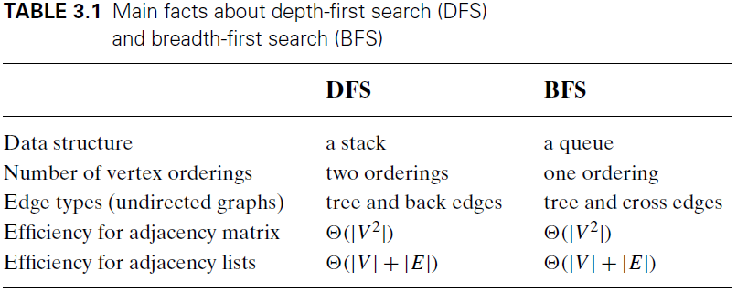
Breadth-First Search
Notes:
Table 3.1 summarizes the main facts about depth-first search and breadth-first search.

